Slide 1
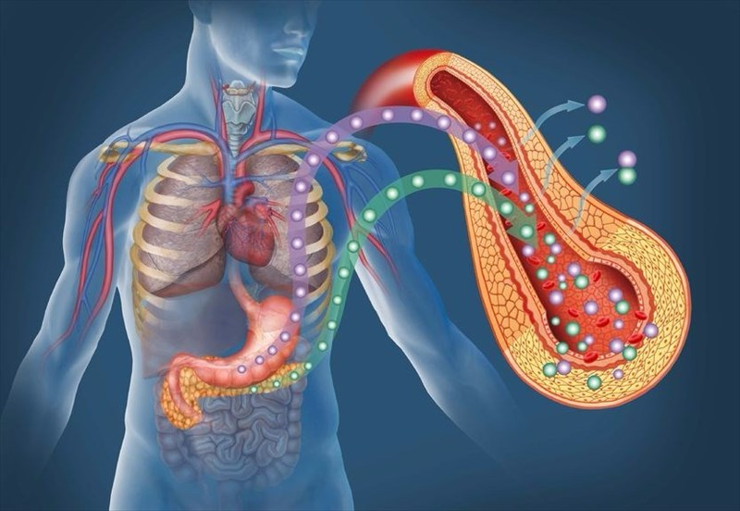
Incretins & the modification of biologicals
BIO-698
Timothée Ferrari
02.11.2023

Slide 2
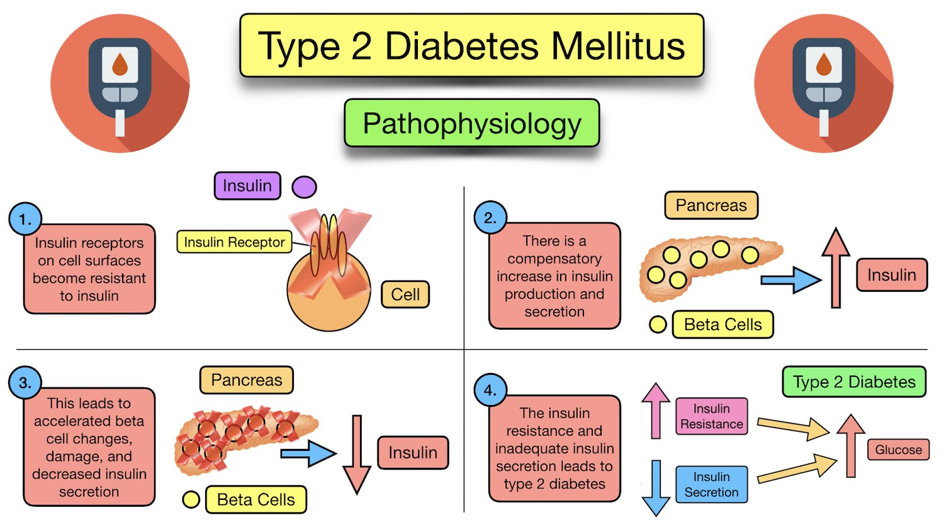
Physiology of diabetes

Slide 3
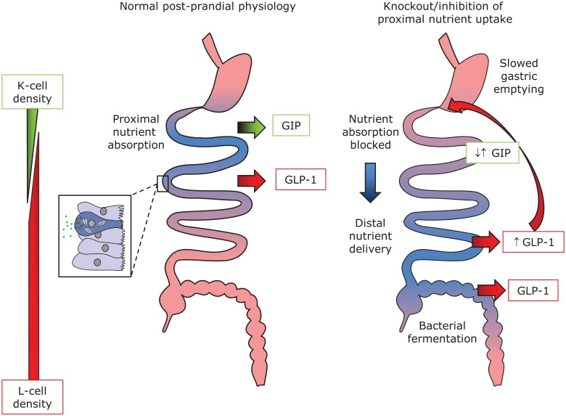

Slide 4
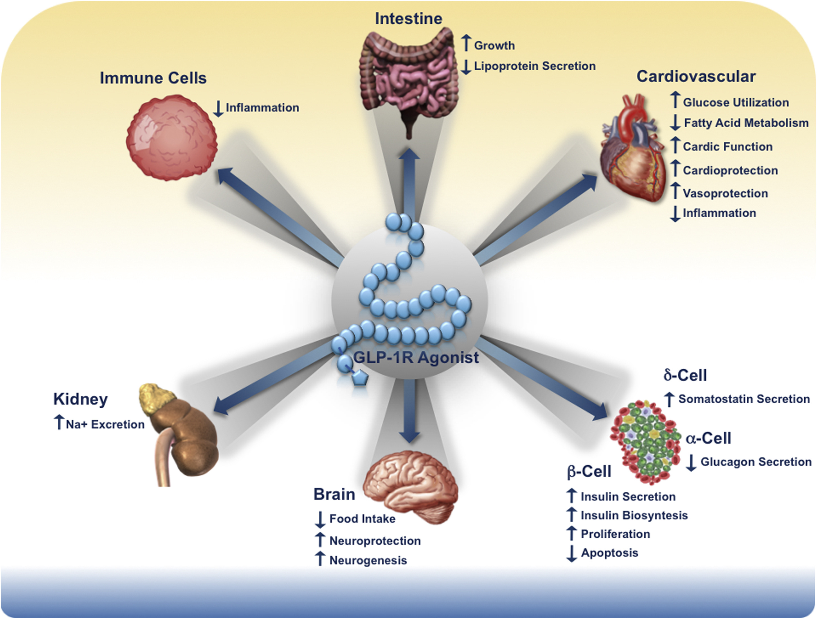
Physiology of incretins
Campbell, Cell Metabolism, 2013

Slide 5
Why they been adopted in the clinics for DM2 control
GLP-1 agonists & GIP
Insulin derivatives
Native gastro-intestinal hormones
Subcutaneous (sc) injections
Stimulate insulin secretion at physiological levels
Affect insulin production levels
Effect is glucose dependent
Native pancreatic hormone
SC or oral
Levels usually dependent on blood glucose
Inhibit gluconeogenesis & opposing glucagon action
Glucose independent

Slide 6
Human GLP-1 agonists aren’t suitable
Half-life of natural GLP-1: ~2min → Clinically insufficient
The Ala in position 8 susceptible DPP-4 degradation
Discovery of Exendin-4 (53% homology with GLP-1)

Slide 7
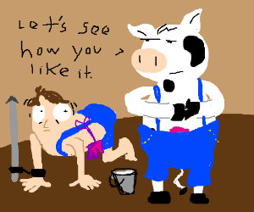
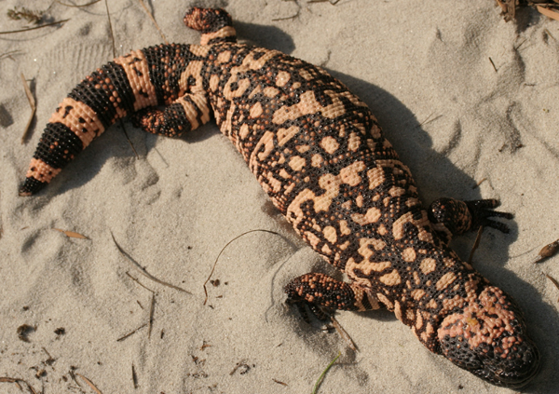
Where does the base molecule come from?
Exendin-4 purified from the Glia monster venom

Slide 8
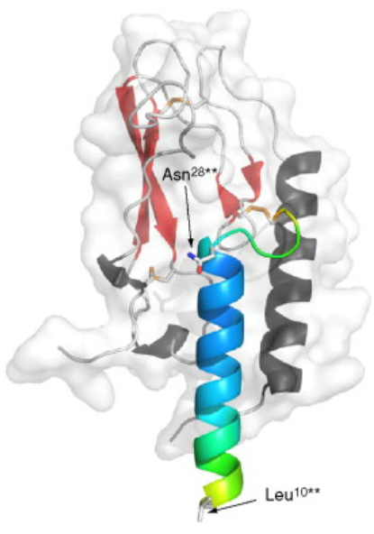
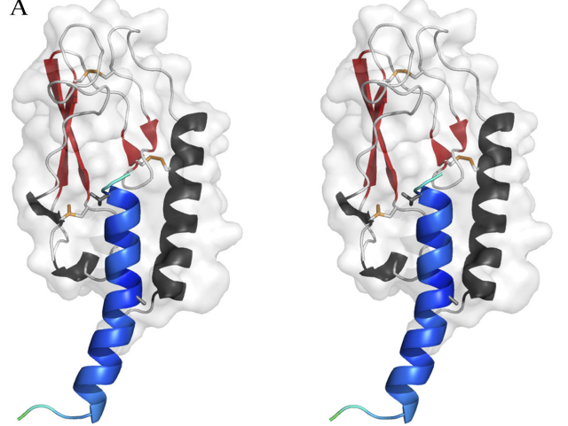
Relationship between exendin-4 & GLP-1
Ex4
GLP-1
39 residue peptide
30 residue peptide

Slide 9
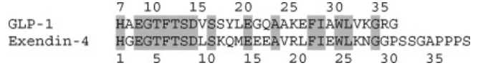
Discovery of liraglutide
Crucial for GLP-1 function
Replace Ala in position 8 for Gly → Inhibit DPP-IV degradation

Slide 10
Encapsulating the proteins
Many different approaches tried to extend half-life
Zinc-chloride formulation: Improved sc precipitation
Rejected: Anaphylactic shock

Slide 11
Using albumin to improve half-life
Human serum albumin (HSA) is an abundant plasma protein
Albumin can bind proteins through fatty acids
Introduction of a gamma glutamate (γGlu) linker

Slide 12
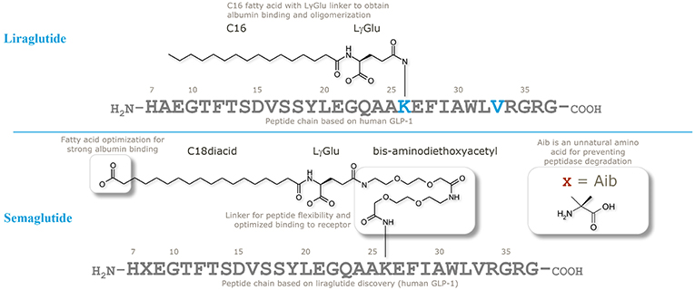
Fatty acid linkers
Theory: The longer the fatty acid the longer the half-life
Reality: Longer fatty acids decrease affinity for GLP-1R
Best solution: Fatty di-acids with distal and proximal fatty

Slide 13
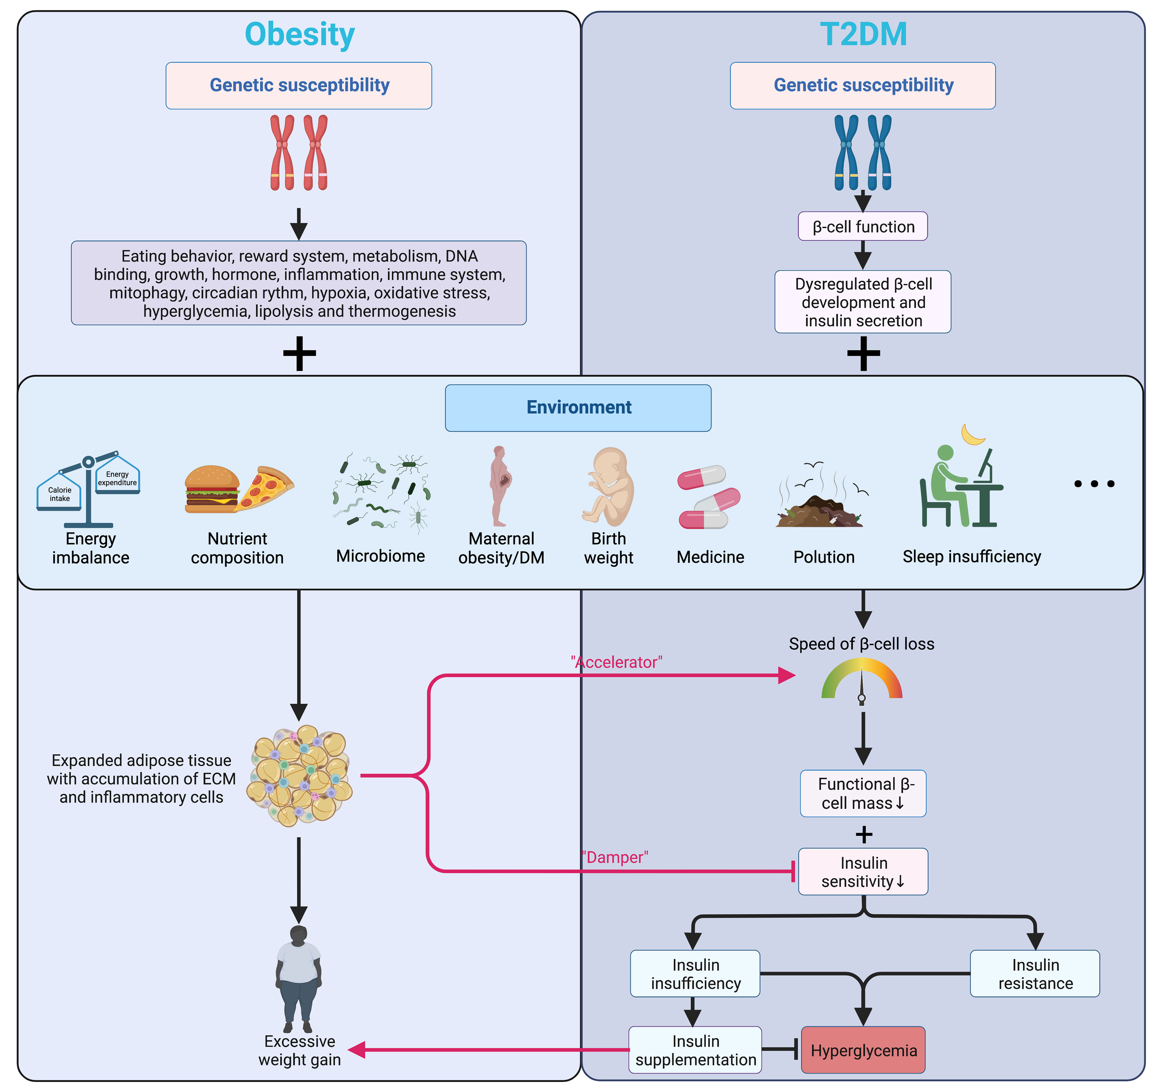

Slide 14



So it’s not just for diabetes

Slide 15
Should we invest more in early hormonal activators/inhibitors?
What is the risk of multiple action hormones?
Should we revisit historically used phytotherapies and invest more in non-human biology ?

